Slide 1
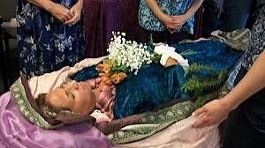
Healing Presence
The Re-emergence of Home Funerals in America
Notes:
Your introduction

Slide 2
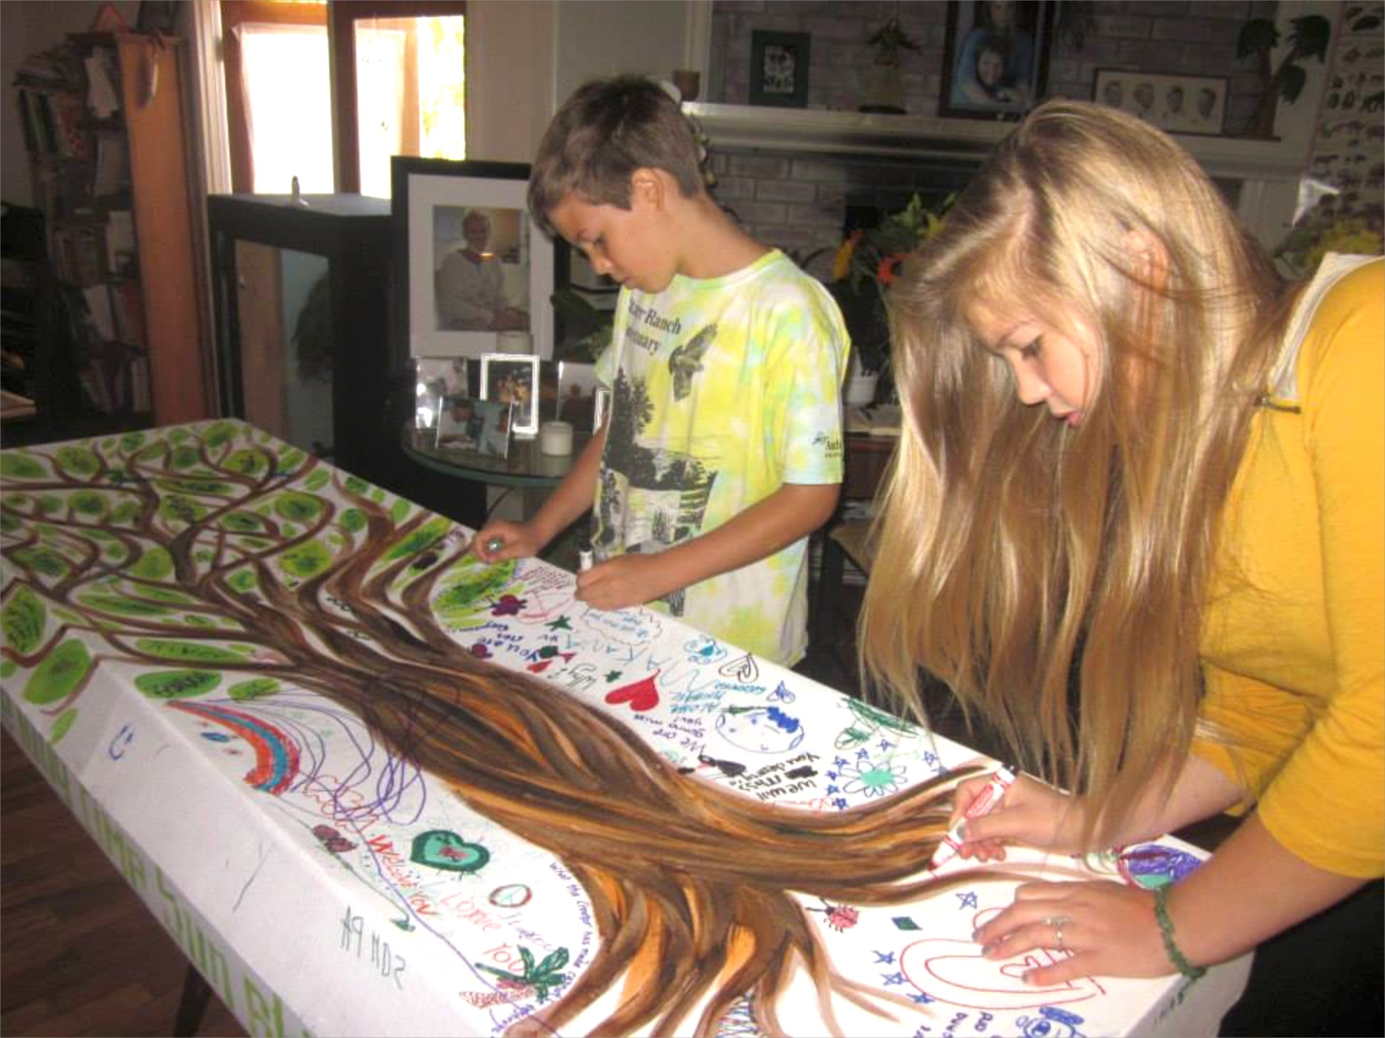
Why Home Funerals?
Our legal right and privilege
Family-led, family-directed
Eco-conscious
Cost conscious
Meaningful
Photo courtesy of Olivia Bareham, Sacred Crossings
Notes:
Assure your audience that you plan to answer their questions
This what you plan to cover in this presentation
Set the tone of what you are to expect from each other
And begin to explain why home funerals are so important

Slide 3
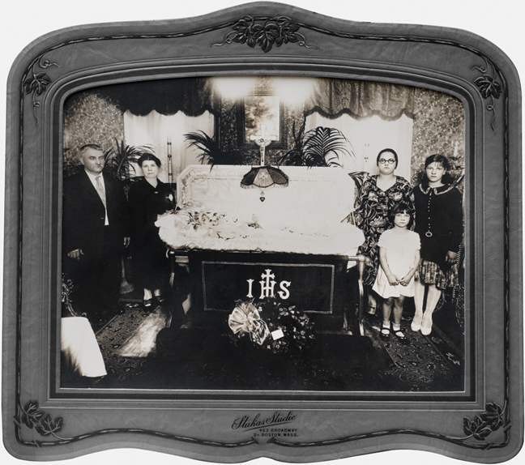
A Brief History
Home funerals the norm
Civil War embalming
Era of hospitals, germs
Rise in professionals
$20B/year in the US
Notes:
Just a quick history to explain how we have come full circle in 100 years or so
Though some families and communities and regions never stopped
Very few countries in the world share US conventional funeral practices
You can mention miasma theory, the desire to mimic affluent families who could afford professionals, that dying became something to overcome rather than something that was part of their culture

Slide 4
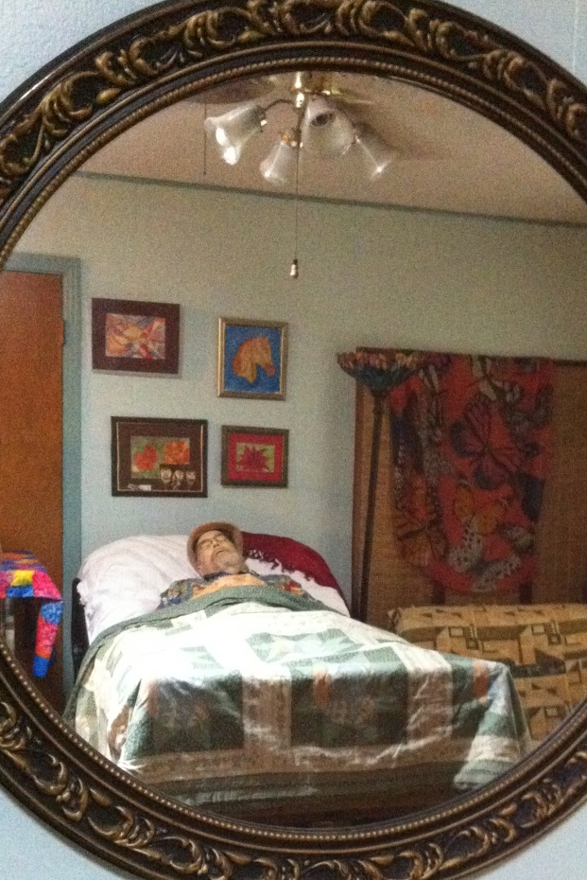
Home Funerals May Include
Bathing and laying out
Home vigil
Home funeral ceremony
Necessary forms
Transportation
Arranging disposition
Photo courtesy of Donna Belk, Beyond Hospice
Notes:
Mention that blended funerals include both family/community and professionals (funeral directors, hospice nurses, nursing home staff, etc.) in some configuration
Funeral directors are available 24/7 and can help with chosen aspects or when needed
Care communities fall under this definition as well (which you may choose to talk about later)
Both private homes and sheltering in a church are considered private, not public, for viewing
That funeral rituals, celebrations, services, etc. may occur in the home, church, hall, or other venue

Slide 5
Emotional Benefits
Create natural flow of events
Normalize the process
Teach children
Promote healthy grief
Feel useful
Find meaning
Inform community
Photo courtesy of Donna Belk, Beyond Hospice
Notes:
Here’s your place to talk persuasively about the many benefits – make it count!

Slide 6
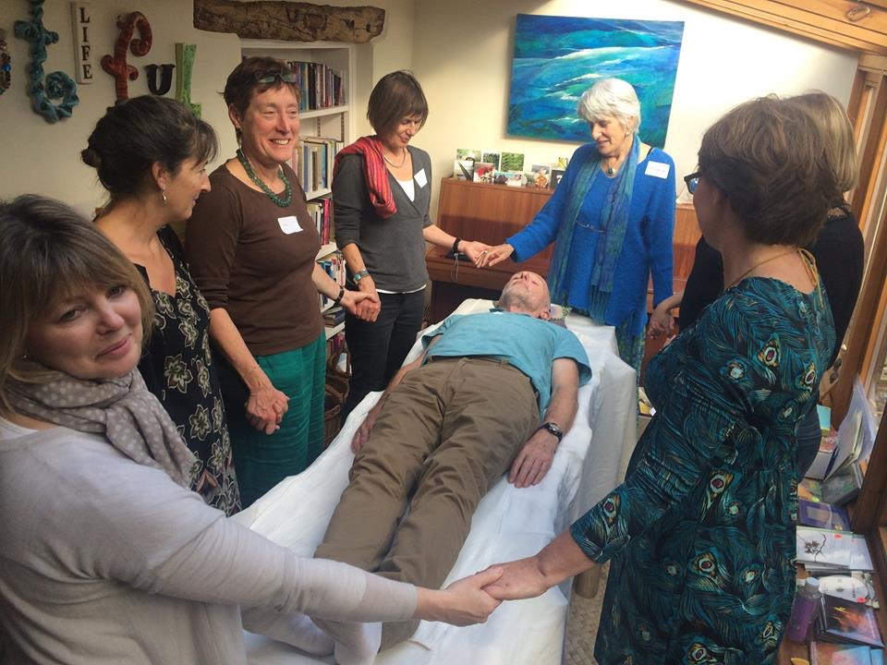
Law Supports Families
Home vigils are legal in every state and province
Embalming is not required by law
9 states compel to hire a professional for non-vigil requirements
Photo courtesy of Jerrigrace Lyons, Final Passages
Notes:
Explain the difference between the laws and the policies that govern funeral homes and cemeteries (embalming a policy for public viewing, not a law)
Explain that keeping the body home and caring for it is legal; it’s the paperwork, transport or disposition details that may require a funeral director in 9 states
That embalming is about looking good “(providing a memory picture”) for the viewing, not about preserving the body

Slide 7
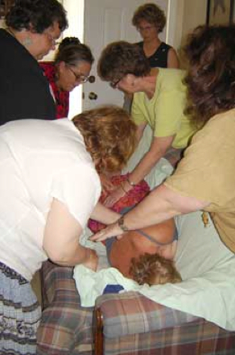
Affordable
Share tasks
Use what is available
File paperwork at no cost
Make final arrangements
Transport with family vehicle
Hire only what you cannot do or are uncomfortable doing
Photo courtesy of Nora Cedarwind
Notes:
Instead of $8-10,000 for a conventional funeral (average according to the NFDA is $8343)
All for a fraction of the cost of a conventional funeral
This is a good way to enumerate all the things families can do themselves and what actually goes into it

Slide 8
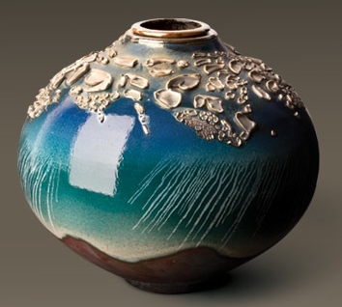
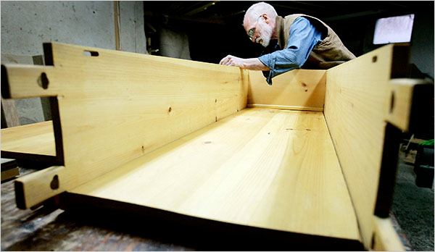
Eco-friendly
Uses what materials are available
Non-invasive practices
Uses dry ice or other non-toxic methods
Locally-made and sourced caskets, shrouds, urns
Organic, natural methods
Photo courtesy of Shine On Brightly
Photo courtesy of New York Times, Chuck Lakin, Last Things
Notes:
Good place to bring out environmental facts (Mary Woodsen) unless you choose to add the Green Connection slide
Mention open windows, air conditioning, Techni-ice

Slide 9
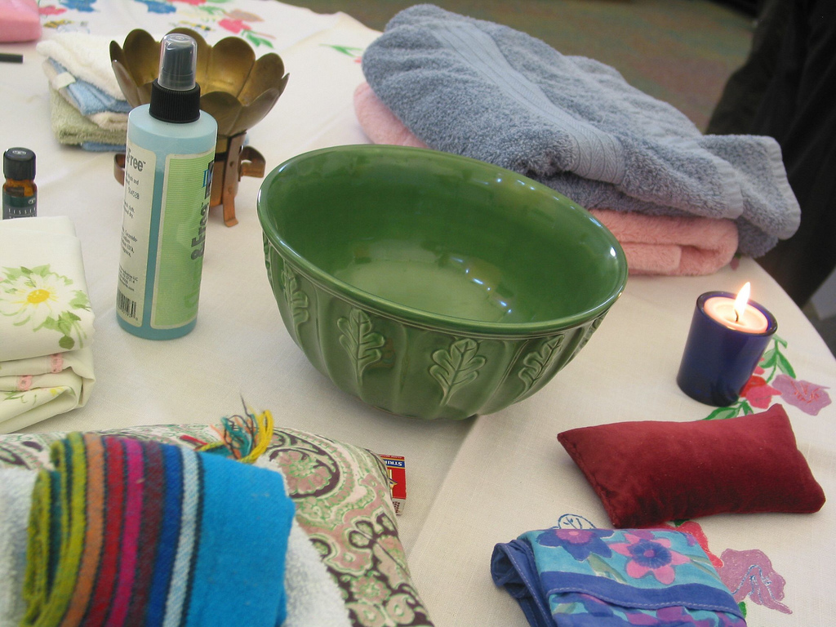
Safe
For caregivers and deceased
Fluids, odors easily managed
CDC, WHO, CID, PAHO agree, “Dead bodies do not pose an increased health risk”
Cool room
Universal precautions
Photo courtesy of Donna Belk, Beyond Hospice
Notes:
Explain that those at most risk from embalming are professional embalmers – 8 times higher incidence of leukemia than average
That universal precautions are gloves and masks primarily in case of blood or other body fluids, either on the deceased or the person doing the cleaning
Known infectious diseases that are of concern are Hepatitis, HIV-AIDS handled with UP just as in life
Creutzfeld-Jakob and Ebola are handled by authorities and not candidates, so no worries
Fluids and odors are managed also by packing when necessary, but it is usually not necessary to get into that in a general public presentation
Fluids and odors are not always present
Techni-ice is available on Amazon for around $5 a sheet, reusable – need 5-6, can be cut

Slide 10
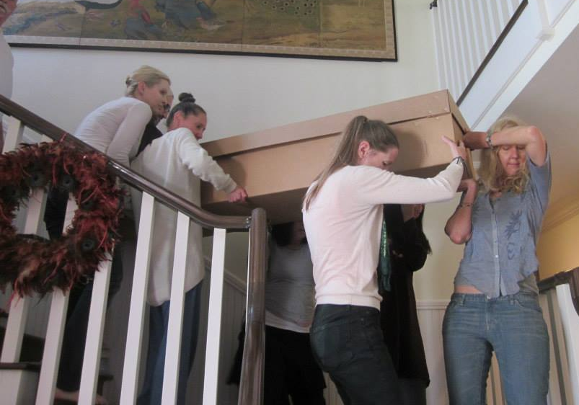
Planning
Advance Directives for health care
Have the family conversation
Written funeral plans
Designated agent
Doctors, clergy, attorney
Who’s going to help
Photo courtesy of Olivia Bareham, Sacred Crossings
Notes:
Mention the three types of ADs— durable power of attorney for health care, durable power of attorney for finances, designated agent for funeral arrangements
Helpful materials—your specific state’s AD forms, the NHFA Planning Guide for Home Funeral Families
Keep originals in the freezer
Prepare family, friends and others needed to make your plans go as you wish
Be sure to include your wishes regarding autopsy or hiring funeral professionals
You may ask for no autopsy on religious grounds though the ME has final say

Slide 11
Home Funeral Guides
Educate about choices
Inform about laws and policies
Demonstrate techniques
Support the family in charge
Respect choices
Honor diverse traditions
Partner with caregivers
Follow wishes of the family
Notes:
Stress becoming fluent in what to do before they need it
Stress alerting others—family members, clergy, doctors, funeral directors—to plans that include them and to what degree

Slide 12
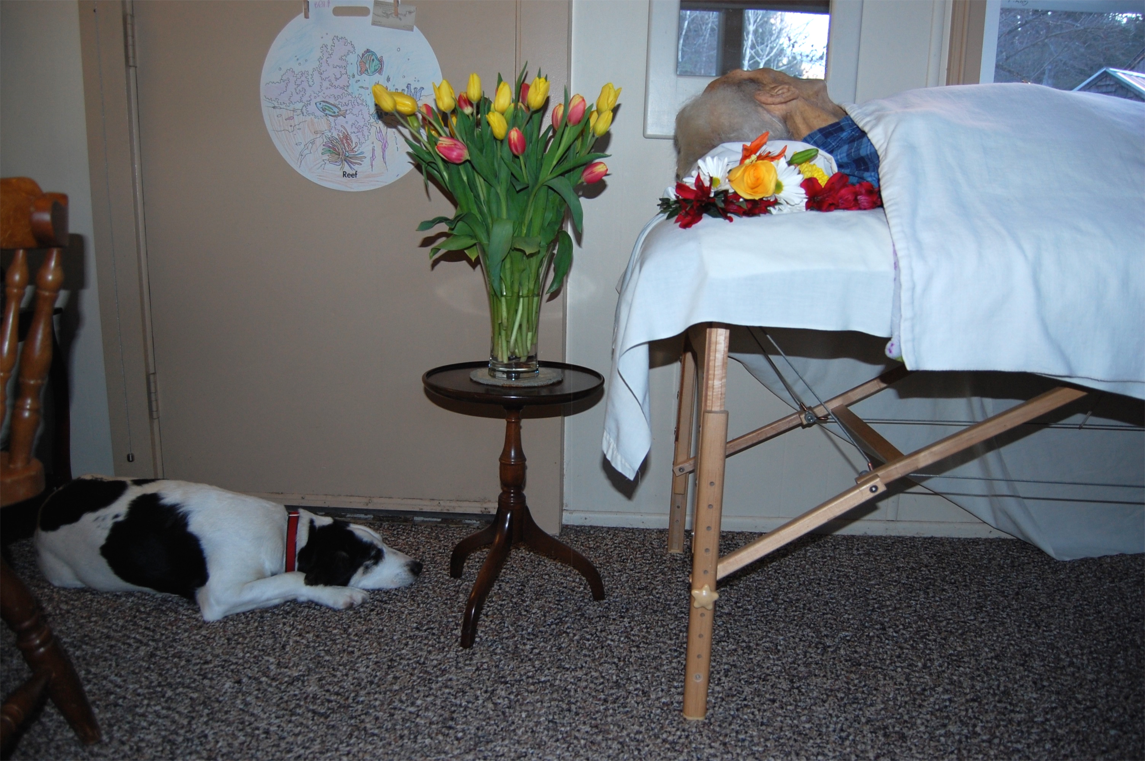
For More Information
Your name
Contact information
What you offer
Your logo
Photo courtesy of Julie Lanoie, New Hampshire Funeral Resources, Education & Advocacy

