Slide 1
Bridging the Death Experience
Helping Families Transition From Hospice Home Care To After-death Home Care
Notes:
This presentation is designed to be given at hospice staff and volunteer in-services and trainings to alert them to the possibility that their hospice family may choose to continue to care for their family member after the death occurs, and how their knowing about home funerals will smooth the way for a full continuum of care.

Slide 2
Today’s Topics
Providing a continuum of care for hospice patients who become home funeral families
State and Federal laws and how they matter to hospice workers and families
Notes:
Let them know you are going to explain what their role is in assisting home funeral families, how home funeral advocates and hospice are alike and different, and what complementary services we offer to patients and families.

Slide 3
A Hospice Home Funeral Story
Your story points
Your story photo
Notes:
Personalize this intro and tell your own story: “I would like to begin by painting a picture for you of a family who had a loved one in hospice and who continued to care for him or her after death”
Use this slide to explain the emotional and spiritual benefits to home funerals. Add the economical benefit if appropriate.

Slide 4
The Needs of the Dying
to be cared for by those who can maintain hope, however fleeting this may be
to participate in decisions concerning one’s care, including advanced directives
for children, family, and friends to participate in whatever way they are comfortable
to know that the sanctity of the body will be respected after death
from David Kessler’s The Needs of the Dying: a guide for bringing hope, comfort, and love to life’s final chapter
Notes:
OPTIONAL if you are short on time
4 concepts we all strive to fulfill

Slide 5
The Needs of the Family
to be treated with honesty, respect, compassion and dignity
to feel validated in their grief and in their spirituality
to know what to expect physically leading up to and after death
to understand the legal issues regarding care and custody of the body
from David Kessler’s The Needs of the Dying: a guide for bringing hope, comfort, and love to life’s final chapter
Notes:
OPTIONAL if you are short on time
Segue concept to stress:
We sometimes treat mourners, whether or not they are distraught or disoriented, like children. Our goal is to empower them, letting them embrace the experience, giving them a chance to work it through, providing the tools of healthy grieving.
Home funerals give people something familiar and important to do once the primary health care is done. Their loved ones may remain at home until ready for disposition, without embalming; they can hold a home vigil; the family can transport with proper documentation (death certificate and permit); they can bathe, dress, and prepare in casket or shroud. They can care for legal details and transportation themselves or hire a professional to help with whatever the family requires.

Slide 6
The Home Funeral Movement
Goals include:
empowering families to care for their own after death
educating the public to their innate family rights
promoting environmentally sound and caring practices
Notes:
Highlight our home funeral mission in general terms – we will get into more specifics later

Slide 7
Our Shared Philosophy
Hospice and Home Funeral advocates believe that patients and families:
are full participants in care decisions
are treated with honesty, respect, compassion and dignity
look to us to feel validated in their grief and in their spirituality
trust us with ensuring that the sanctity of the body will be respected
need to know what to expect leading up to and after death
Notes:
Stress our common mission that patients and families:
full participants in care decisions, including advanced directives and funeral planning
treated with honesty, respect, compassion and dignity
look to us to feel validated in their grief and in their spirituality
trust us with ensuring that the sanctity of the body will be respected
need to know what to expect leading up to and after death

Slide 8
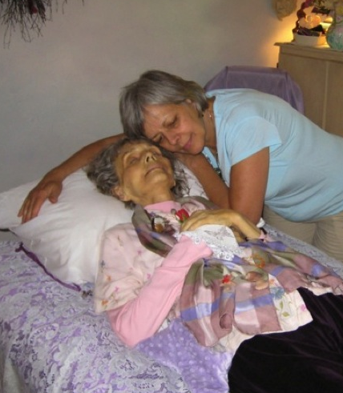
Home Funerals are Legal and Safe
families may keep patients home after death in all states
embalming is not required by any state for home funerals
according to the CDC, NCID, PAHO & WHO, bodies do not pose an increased risk of infection after death
cooling techniques sufficient
body cleanliness is key
universal precautions only if necessary
Photo courtesy of Jerrigrace Lyons, Final Passages
Notes:
Stress positive aspects of family care and that is is both legal and safe
Underscore that even hospice families need time to absorb the loss and gather loved ones near, regardless of how long they cared for the person

Slide 9
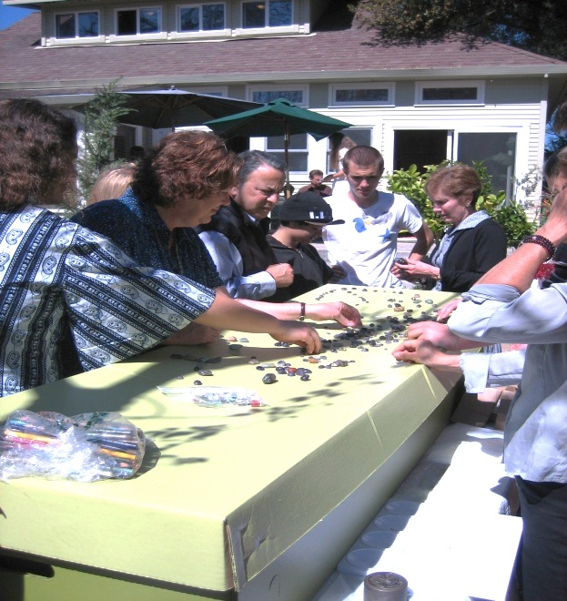
What Home Funeral Families May Do
contact appropriate authorities
conduct care of deceased
shelter deceased in home
ensure death certificates are filed, permits are obtained and filed *
arrange for cemetery or crematory *
transport the body *
* Except where state law compels families to hire a professional to do these tasks: CT, IL, IA, IN, LA, NY, MI, NB, NJ
Photo courtesy of Final Passages
Notes:
Assure the hospice staff that the family knows what to do
Suggest that funeral directors be engaged if the family desires or if there are legal requirements

Slide 10
The Role of Home Funeral Guides
Home funeral guides teach, advise, and consult with families to:
preplan
file documentation
prepare and bathe the body
procure burial and cremation vessels
acquire permits for transportation
locate crematory, cemetery contact information
write obituary or memorial announcements
prepare the home for services or visiting
create a unique, intimate ceremony
include clergy, musicians, funeral directors
obtain funeral goods and services
Empowering others to make informed decisions about end-of-life & after death care
Notes:
Assure the hospice staff that you know what you are talking about

Slide 11
What Hospice Personnel Need to Know
“…the funeral director, next-of-kin, or designated agent…”
Find and cite here the exact laws in your state that:
define next-of-kin’s right to custody and control of the body
state when the hospice nurse has fulfilled his or her duties (Example: “…after certifying the fact of death and completing the death record…”)
direct nurse to complete the medical portion and give it to the next-of-kin to obtain physician’s signature and cause of death
indemnify the nurse and hospice from legal responsibility (Example: Any person or institution releasing a body…shall be held harmless against and shall not be liable...”)
Notes:
You have to construct this slide.
Do your homework and cite specific laws that protect the home funeral family AND the hospice nurse and personnel as indicated above in RED.
Let them know that they may be invited to stay and help, but they are not required to after they have signed the death certificate and surrendered it to the next-of-kin who is now in charge.
If their agency has a policy that requires more than what is stated in the law, suggest helping with getting their policy compliant with the law for the protection of the family and the employees.
Let them know that any professional work on behalf of the hospice organization beyond the signature is voluntary. If they insist on calling a funeral director or in any other way impede family members from enacting their rights, it may put the agency and them personally in a potentially sticky legal situation (acting without authority; not recognizing legal entity responsible; attempting to impede constitutional rights; HIPAA violations, etc.)

Slide 12
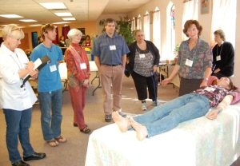
HIPAA Consent to Share Information
Admission forms ask permission to share with:
physicians and other health care providers
Medicare and other insurance providers
Consent to share list specifies:
individuals, next-of -in, designated agents
legal guardians
HIPAA 45 CFR 164.510(b), ensures that an individual’s health care information remains private even after death
164.512 (2)Funeral directors. A covered entity [hospice] may disclose protected health information to funeral directors [next of kin or designated agent]…as necessary to carry out their duties with respect to the decedent…
Photo courtesy of the National Home Funeral Alliance
Notes:
Cite HIPAA rules concerning confidentiality of hospice patient rights even after death. A contract between a funeral director and the family does not involve hospice unless there is a qualifying medical reason to disclose information. If the family is acting as its own funeral director, that medical information may be shared with them. Hospice nurses interface with funeral homes only at the request of the family.

Slide 13
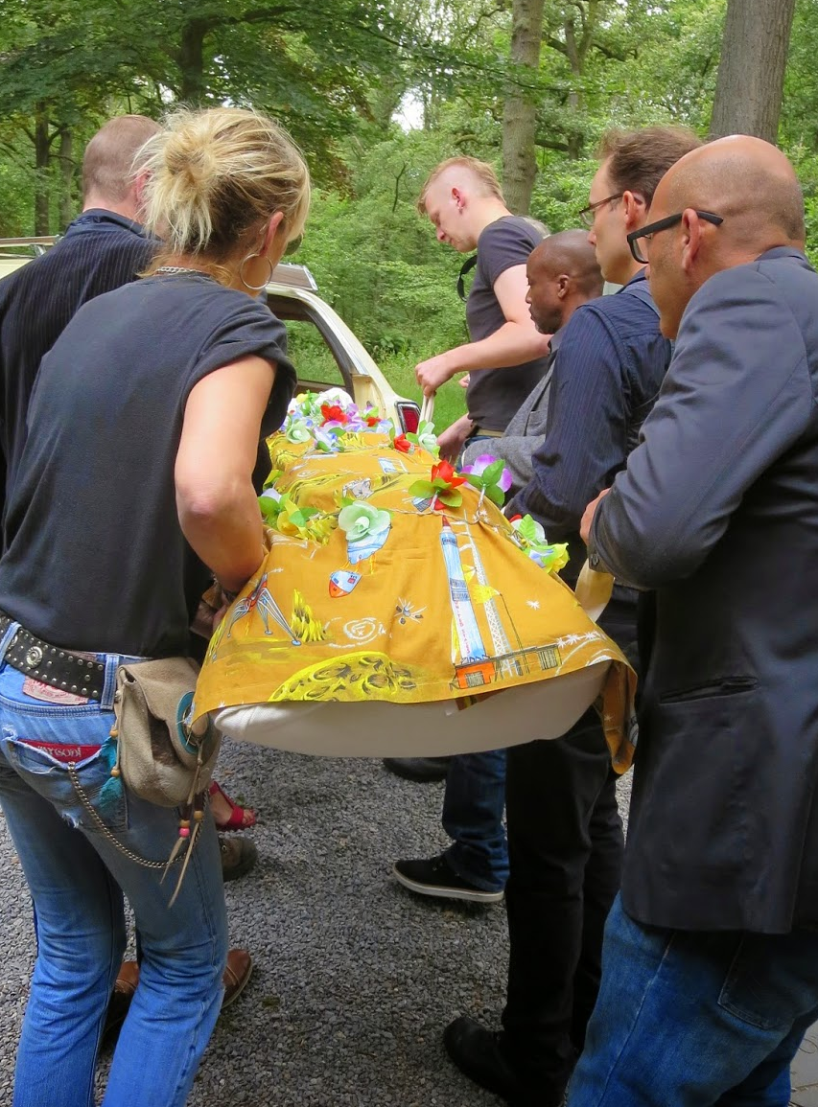
Expanding Your Hospice Services
Offer to arrange a funeral planning visit
What a funeral planning visit entails:
facilitating a funeral discussion with patient, if possible
educating families about home and blended funeral care
At admission, the planner:
offers comparative area funeral home information along with home funeral information
assists in developing an action plan
Photo courtesy of Respect EveryBody Shrouds
Notes:
OPTIONAL – use only if you are offering this volunteered service
Suggest that they consider offering volunteer services of a funeral planner (hopefully you) to let patients who are interested know more about funeral options in your area, including home funerals. Be sure in this role that you offer fair and impartial information.
Suggest that having someone on call for funeral planning will lighten their workload and provide added value to their service.
Suggest that you partner with local funeral directors to provide this service if desired.

Slide 14
For More Information
National Home Funeral Alliance homefuneralalliance.org
The Funeral Consumers Alliance acts as a legal watchdog, advocacy federation, and provides consumers with accurate information funerals.org
Final Rights: Reclaiming the American Way of Death by Josh Slocum & Lisa Carlson
Notes:
You might also change this slide to focus exclusively on NHFA materials on the website and mention Facebook to drive them to become members and find resources, validating your expertise and connection

Slide 15
What Home Funeral Families Say
Add quote(s) from your hospice/home funeral family
Notes:
Get quotes and leave some time here for people to read them as you prepare to wrap up, telling them that the people who can best attest to the healing benefits of home funerals are their own hospice families. This loops around to the beginning and gives audience a finished feeling

Slide 16
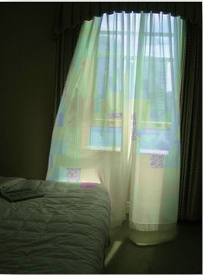
Your Name or Organization Name
State your focus here:
Educational Presentations
Trainings and Seminars
Home Funeral Advocacy
Natural Burial Advocacy
Your name
Address
Email
Phone
Your logo
Description of your organization

