Slide 1
HOME FUNERALS FOR VETERANS

Slide 2
Concerns WE WILL ANSWER
Are home funerals legal?
Are there health risks?
Who will take care of me?
What death benefits does the VA provide?
How can I make sure my plans are carried out?
Notes:
Assure your audience that you plan to answer their questions
This what you plan to cover in this presentation
Set the tone of what you are to expect from each other
These questions will be answered in detail with a later slide specific to Veteran cemeteries and burial benefits.

Slide 3
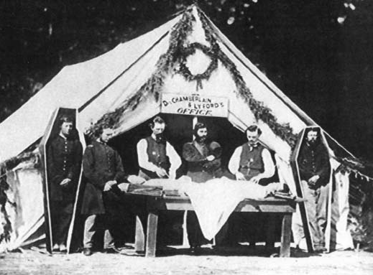
Funeral history began
with families and communities caring for their own
until Civil War surgeons began embalming
creating a new profession
that is now a $20B a year industry in the USA
Notes:
Just a quick history to explain how we have come full circle in 100 years or so
Though some families and communities and regions never stopped
Very few countries in the world share US conventional funeral practices

Slide 4
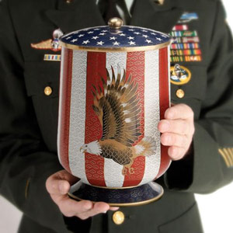
Legal Questions
home funerals are legal in every state
9 states require a professional
embalming is never required by law
cremains may be scattered anywhere, including national & state parks
with permission on private lands
(CT, IL, IA, IN, LA, MI, NE, NJ, NY)
Notes:
Explain the difference between the laws and the policies that govern funeral homes and cemeteries
Explain that keeping the body home and caring for it is legal; it’s the paperwork, transport or disposition details that may require a funeral director
That embalming is about looking good “(providing a memory picture”) for the viewing, not about preserving the body
That vaults are for ease of cemetery maintenance, not preservation of the body
That state and national parks ask that you be discreet when scattering

Slide 5
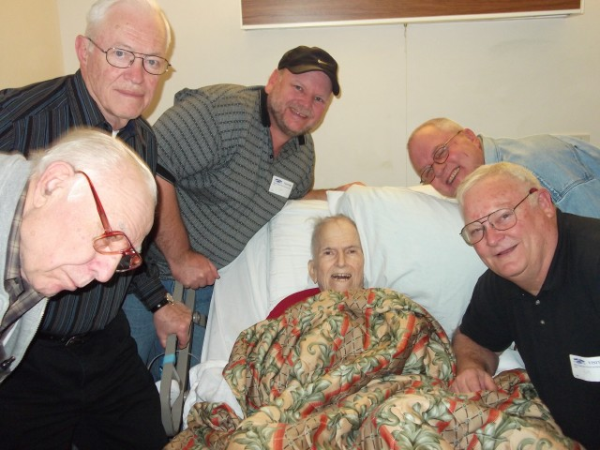
A home funeral may include
being cared for at home
by family and friends
lying in honor 1-3 days
honor guard
at home, in a sanctuary, fellowship hall or graveside
before being transported to final rest
Notes:
Mention that blended funerals include both family/community and professionals (funeral directors, hospice nurses, nursing home staff, etc.) in some configuration
Funeral directors are available 24/7 and can help with chosen aspects or when needed
Care communities fall under this definition as well (which you may choose to talk about later)
Both private homes and sheltering in a church are considered private, not public, for viewing
That funeral rituals, celebrations, services, etc. may occur in the home, church, hall, or other venue

Slide 6
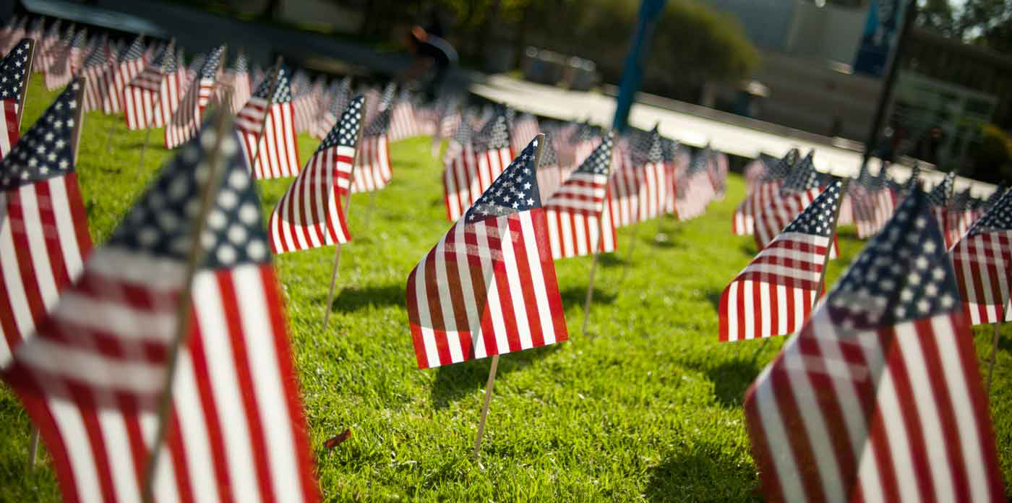
Home funerals are healing
more time for friends and family to gather
natural flow of events, emotions
give people a chance to be useful
reduce fears
teach cycle of life
embrace grief
Notes:
Here’s your place to talk persuasively about the many benefits

Slide 7
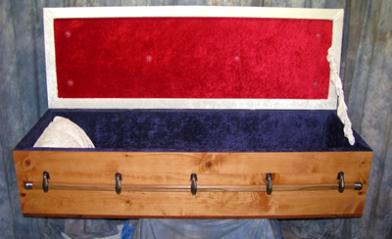
Home funerals are affordable
family, friends, vets share tasks
file necessary documents
transport the body
arrange for clergy or celebrant
make cemetery or crematory arrangements
use locally sourced and crafted funeral goods
file online or newspaper obituaries
Notes:
Instead of $7-10,000 for a conventional funeral – could cost as low as $500 DIY.
All for a fraction of the cost of a conventional funeral
This is a good way to enumerate all the things families can do themselves and what actually goes into it
Caskets could be made by your friends

Slide 8
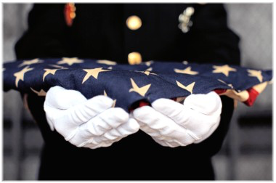
Home funerals are safe
for caregivers and the deceased
according to the CDC, WHO, CID “…a dead body does not pose an increased [health] risk”
keep cool with ice or AC
or in a 65° room for up to 3 days
no need for embalming or disinfecting
use universal precautions when desired
Notes:
Explain that those at most risk from embalming are professional embalmers – 8 times higher incidence of leukemia than average
That universal precautions are gloves and masks primarily in case of blood or other body fluids, either on the deceased or the person doing the cleaning
Known infectious diseases that are of concern are Hepatitis, HIV-AIDS handled with UP just as in life

Slide 9
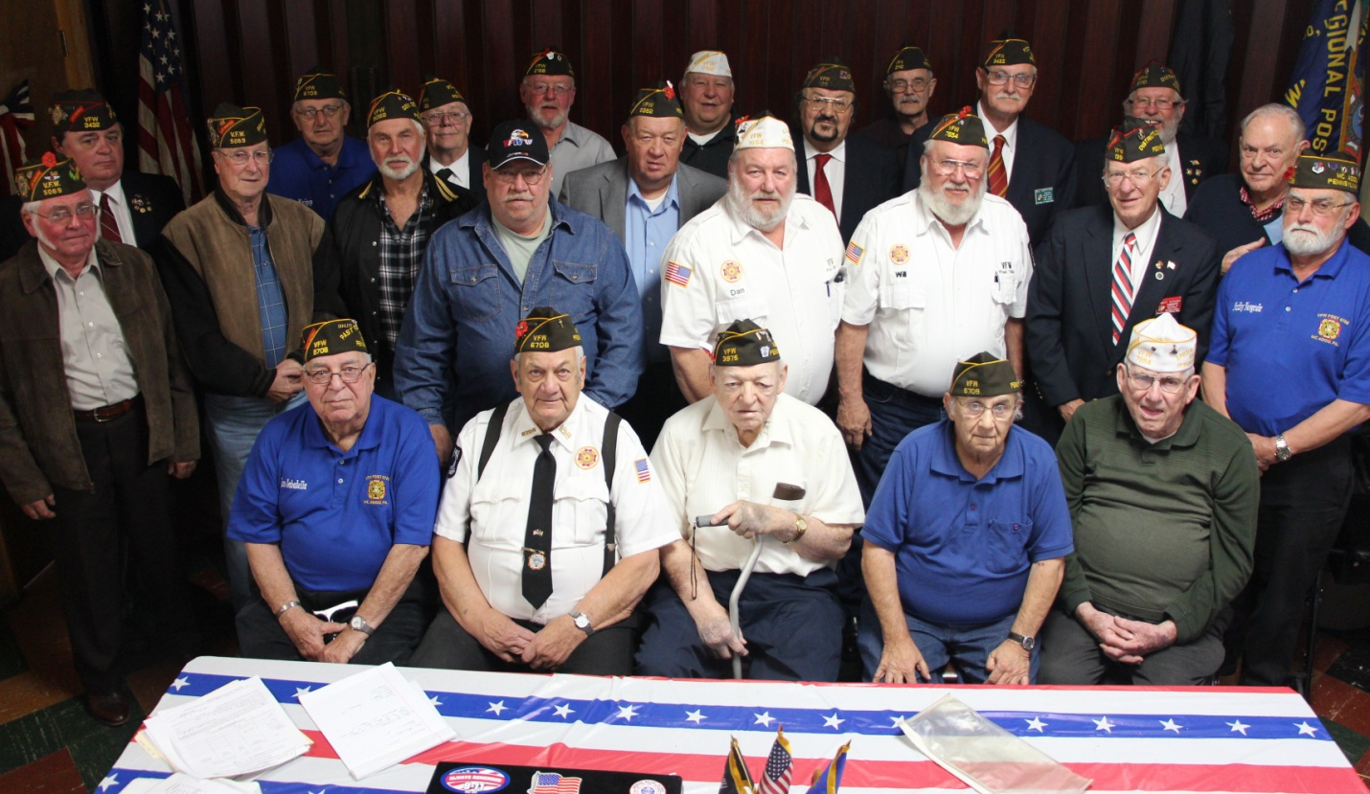
Veterans’ Needs, Beliefs, Values
★ Teamwork  Service  Honor 
Few can so effectively express our shared emotional ties to the ideals of family and country as those who have fought to protect them.

Slide 10
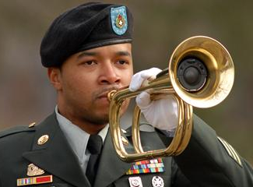
National Veteran cemeteries
131 national & state cemeteries
cremains treated same as burial
cannot be reserved
must have discharge papers
service-related death $2000 allowance
non-service related death $300 burial, $745 plot
VA may reimburse all or part of transportation costs
Notes:
We may really want some notes in here depending on how the first few go, the feedback we get.
Burial allowance is in addition to the VA benefits above.

Slide 11
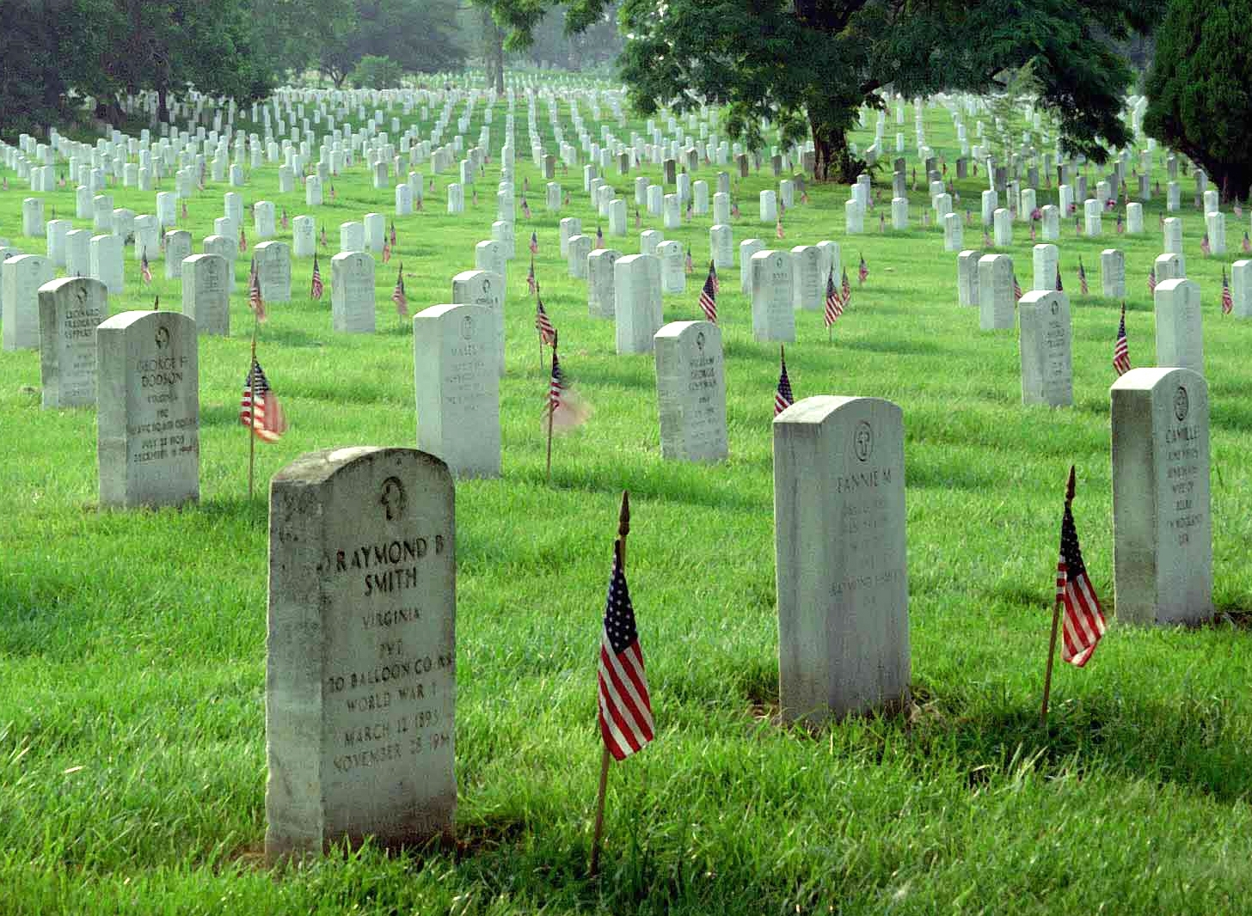
VETERAN burial benefits
Veteran benefits include:
Presidential Memorial Certificate
gravesite where available
opening, closing of grave
headstone/marker
perpetual care
US flag

Slide 12
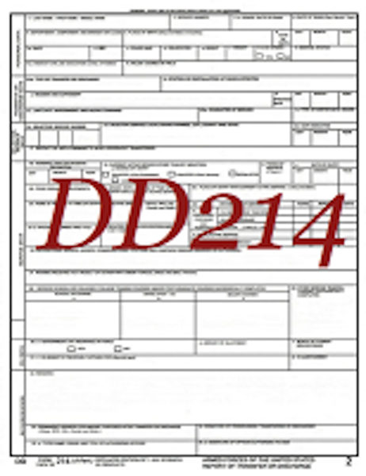
Good planning includes
informing your Veteran’s circle
completing all necessary Veteran documentation
writing down funeral wishes
designating someone to carry them out
informing doctors, clergy, family, VA service organizations
Notes:
Mention the three types of ADs— durable power of attorney for health care, durable power of attorney for finances, designated agent for funeral arrangements
Helpful materials—your specific state’s AD forms, Five Wishes, etc.
Keep originals in the freezer
Prepare family, friends and others needed to make your plans go as you wish
Be sure to include your wishes regarding autopsy or hiring funeral professionals
You may ask for no autopsy on religious grounds though the medical examiner has final say

Slide 13
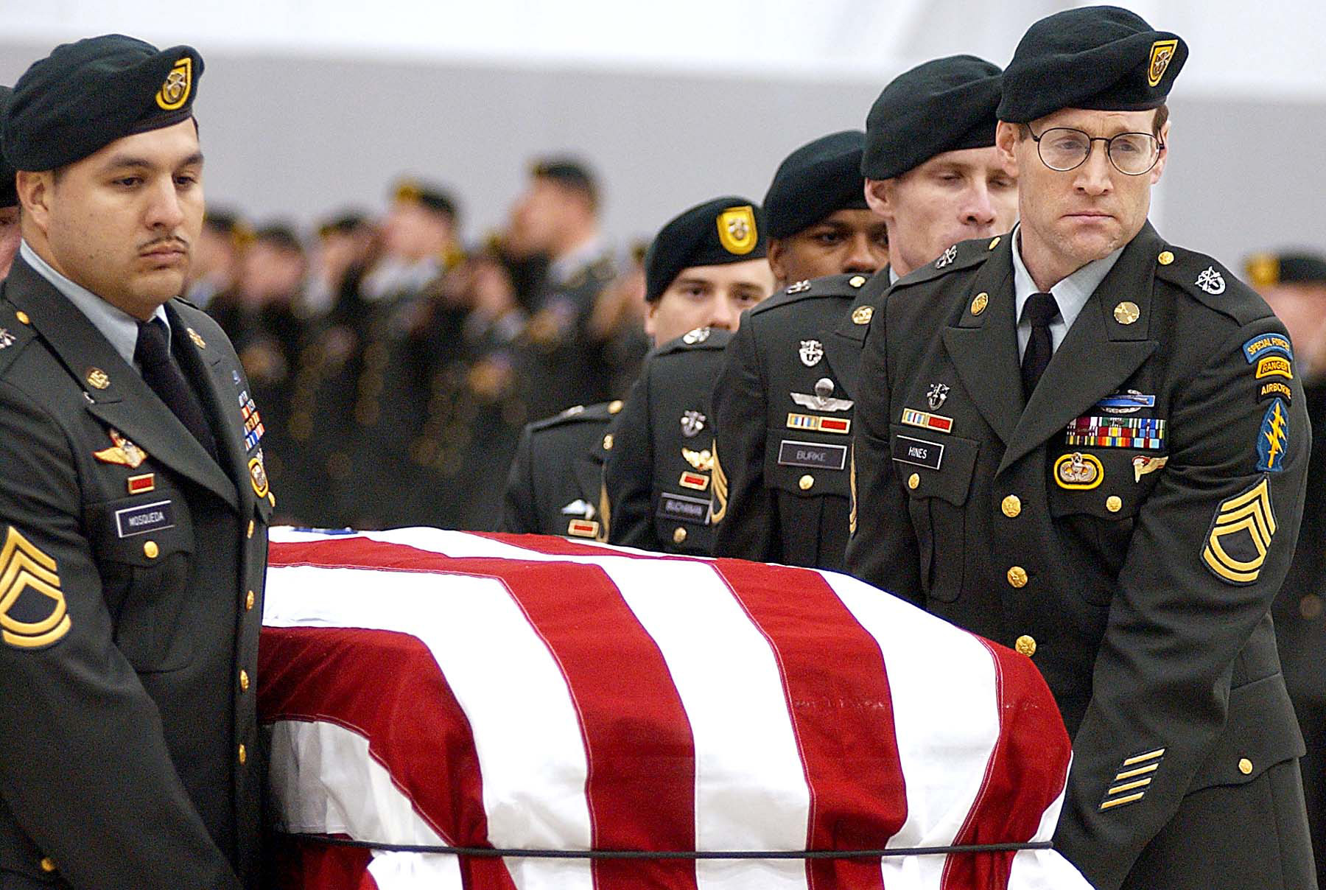
Home funeral guides
respect and honor Veterans and their needs
educate families and the public about choices
provide support and information
respect personal choices
honor diverse spiritual traditions
partner with other caregivers
Notes:
Stress that they need to become fluent in what to do before they need it
Stress alerting others—clergy, funeral directors—to plans to include them and to what degree

Slide 14
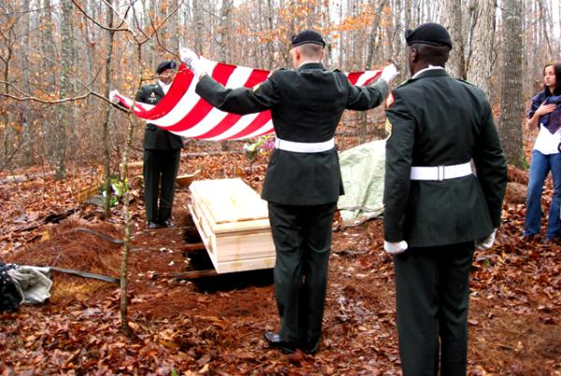
GREEN BURIAL FOR VETERANS
Photo courtesy of Billy and Kimberley Campbell, Ramsey Creek Conservation Preserve

Slide 15
For more information…
{Your name and website information, logo and phone}
VA Administration contact info
Burial/Death department for Vets info
www.homefuneralalliance.org

